Slide 1
Predictive Modeling
Learning Session
July 2018

Slide 2
Predictive Modeling
Regression Modeling
Linear Regression
Logistic Regression
Multivariate Adaptive Regression Splines (MARS)
Generalized Additive Model (GAM)
Latent Variable Model
Decision Tree Modeling
Decision Tree Basic
Random Forest (RF)
Xtreme Gradient Boosting (XGB)
Time Series Modeling
Time Series Basics
Basic Time Series Modeling
Exponential Smoothening
ARIMA
Croston’s Model
Dynamic Time Series Model
Hierarchical Model
Model Selection
TOPICS TO BE COVERED

Slide 3

TIME SERIES MODELING

Slide 4
Time Series Data: Data related to any event / metric logged at different intervals of time
Cycle: Patterns which appear, like increase or decrease, but not at fixed interval of time. The time duration of repetition of these pattern is typically long, for example 2 years or so
Seasonality: Pattern in time series repeating after a regular interval of time
Time Series Decomposition: Breaking down of time series into seasonality, trend and remainder component
Trend: Typical pattern being followed by the time series, like, being increasing or decreasing or sinusoidal etc.
Random walk: Pattern where pre-determining the direction of time series is impossible, literally random
Autocorrelation: Measure of linear relationship between lagged values of time series
Stationarity: A Time Series whose properties do not depend on the time at which the series is observed
SOME KEYWORDS

Slide 5
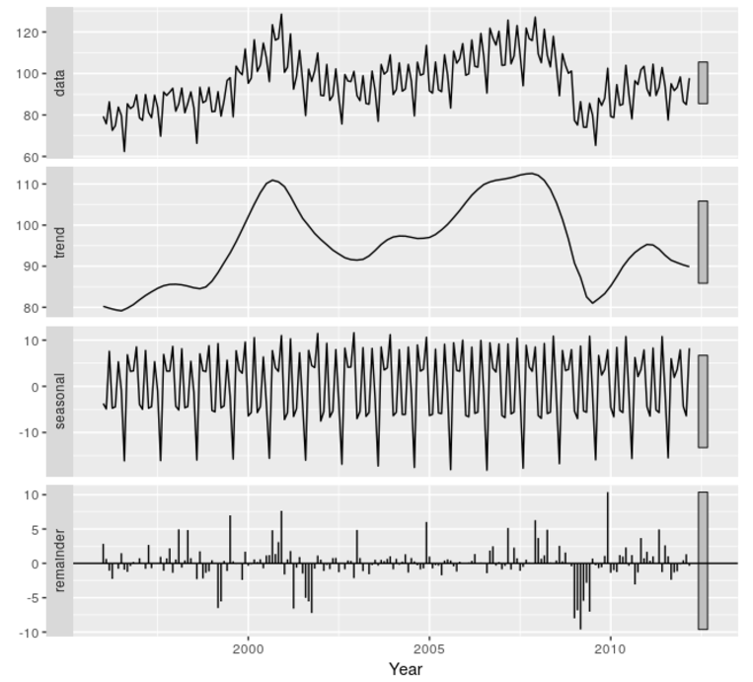
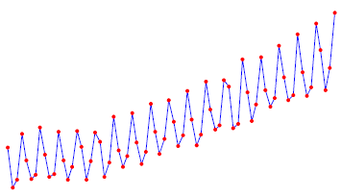
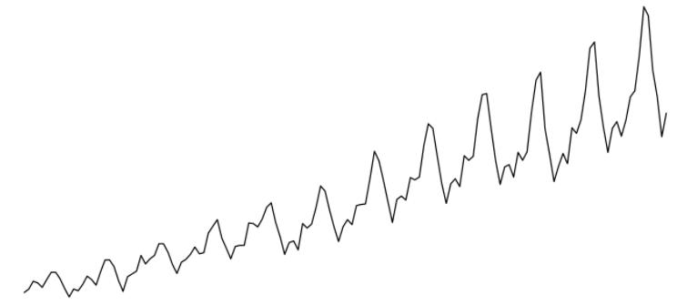


Breaking down the time series into seasonal, trend-cycle and remainder component
Additive Decomposition
$$y_{t}= S_{t}+ T_{t}+R_{t}$$
Multiplicative Decomposition
$$y_{t }= S_{t} ∗ T_{t} ∗ R_{t}$$
Seasonally Adjusted Time Series: Time Series left after removing the seasonal component. Seasonally Adjusted component has trend-cycle and remainder component
TIME SERIES DECOMPOSITION

Slide 6
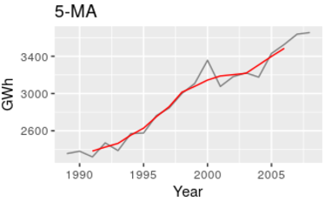



Trend Cycle Estimation - Moving Average Smoothing
$$T_{t}= \frac{1}{m}\sum_{j=−k}^{k}{y_{t+j}}$$
Example – Odd point MA
Year | Sales (GWh) | 5-MA
1989 | 2354.34 | -
1990 | 2379.71 | -
1991 | 2318.52 | 2381.53
1992 | 2468.99 | 2424.56
1993 | 2386.09 | 2463.76
1994 | 2569.47 | -
1995 | 2575.72 | -
No estimate for initial and end values
Odd point moving average is symmetric
$$y=\frac{1}{5}\left(y_{t−2}+ y_{t−1}+ y_{t}+ y_{t+1}+ y_{t+2}\right)$$
Example – Even point MA
Even point moving average is non-symmetric
Year | Sales (GWh) | 4-MA | 2x4-MA
1989 | 2354.34
1990 | 2379.71 | 2380.39
1991 | 2318.52 | 2388.33 | 2384.36
1992 | 2468.99 | 2435.77 | 2412.05
1993 | 2386.09 | 2500.07 | 2467.92
1994 | 2569.47 | 2510.43 | 2505.25
1995 | 2575.72 | 2572.60 | 2541.51
$$y=\frac{1}{4}\left(y_{t−2}+ y_{t−1}+ y_{t}+ y_{t+1}\right)$$
mxEven point moving average is symmetric
$$y=\frac{1}{2}\left[\frac{1}{4}\left(y_{t−2}+ y_{t−1}+ y_{t}+ y_{t+1}\right)+\frac{1}{4}\left(y_{t−1}+ y_{t}+ y_{t+1}+ y_{t+2}\right) \right]$$
$$ y= \frac{1}{8}y_{t−2}+ \frac{1}{4}y_{t−1}+ \frac{1}{4}y_{t}+ \frac{1}{4}y_{t+1}+ \frac{1}{8}y_{t+2}$$
Techniques typically used for time series decomposition
X11 Decomposition
SEATS Decomposition
STL Decomposition
TIME SERIES DECOMPOSITION

Slide 7
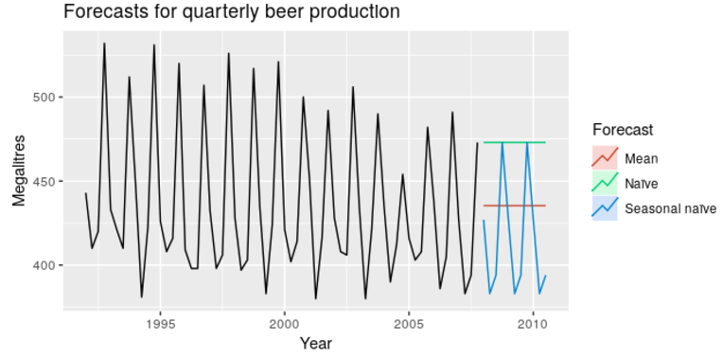
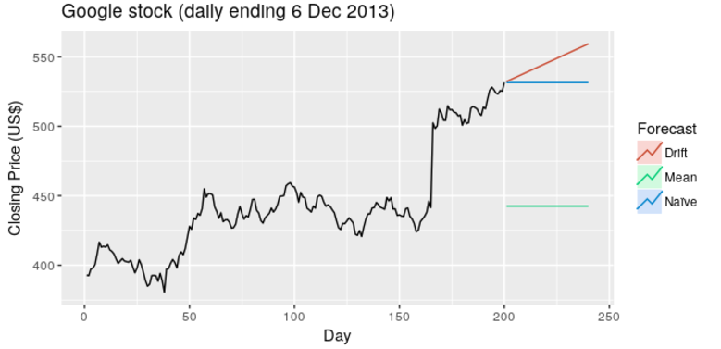
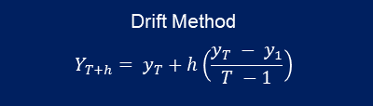


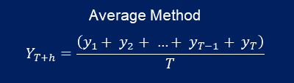
BASIC FORECASTING METHOD
Average Method
Naïve Method
Seasonal Naïve Method
Drift Method
Future values are same as average of the historical values
Future values are same as last observation – also called as random walk forecast
Future values are same as last season value – for e.g. future Feb value will be same as last year’s Feb value
Future value are same as average change seen over time in historical data
Average Method
$$Y_{T+h}=\frac{\left(y_{1}+ y_{2}+ …+ y_{T−1}+ y_{T}\right)}{T}$$
Naïve Method
$$Y_{T+h}= y_{T}$$
Seasonal Naïve Method
$$Y_{T+h}=Y_{T+h −m(k+1)}$$
Drift Method
$$Y_{T+h}= y_{T}+h\left(\frac{y_{T} − y_{1}}{T −1}\right)$$
BASIC FORECASTING METHOD

Slide 8
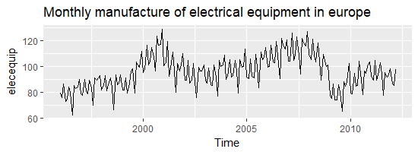
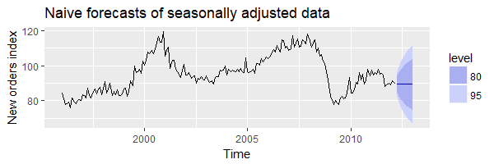
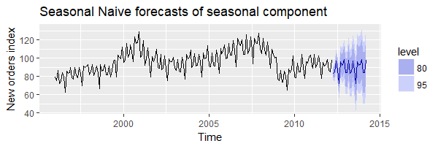
FORECASTING USING TIME SERIES DECOMPOSITION
Forecast Seasonally Adjusted Component
Forecast Seasonal Component
Any non-seasonal forecasting method, like non-seasonal ARIMA, random walk with drift etc. can be used to forecast the seasonally adjusted component
Seasonal Naïve is typically used to forecast seasonal component assuming seasonal component doesn’t change much over time
BASIC FORECASTING METHOD

Slide 9
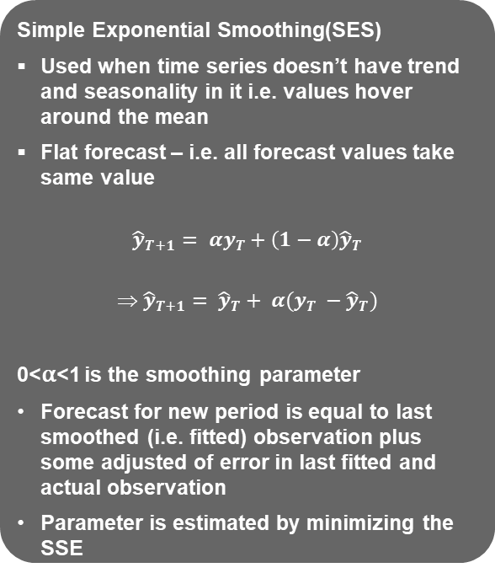
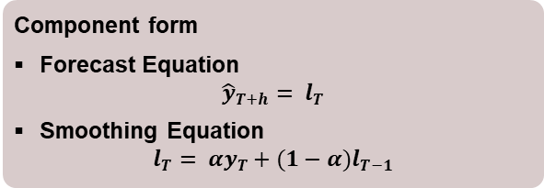
Forecasts produced using exponential smoothing methods are weighted averages of past observations, with the weights decaying exponentially as the observations get older. In other words, the most recent observation would have highest weight and the older observations would have lower associated weight
Simple Exponential Smoothing(SES)
Used when time series doesn’t have trend and seasonality in it i.e. values hover around the mean
Flat forecast – i.e. all forecast values take same value
$${\hat{y}}_{T+1}= αy_{T}+\left(1−α\right){\hat{y}}_{T}$$
$${ \hat{y}}_{T+1}= {\hat{y}}_{T}+ α(y_{T} −{\hat{y}}_{T})$$
0<α<1 is the smoothing parameter
Forecast for new period is equal to last smoothed (i.e. fitted) observation plus some adjusted of error in last fitted and actual observation
Parameter is estimated by minimizing the SSE
Month | Sales (Billions) | Alpha = 0.6
Jan-17 | 97.60 | -
Feb-17 | 95.10 | 97.60
Mar-17 | 90.30 | 96.10
Apr-17 | 92.50 | 92.62
May-17 | 94.60 | 92.55
Jun-17 | 91.00 | 93.78
Jul-17 | 90.20 | 92.11
Aug-17 | 93.00 | 90.96
Sep-17 | 93.80 | 92.19
Oct-17 | 97.00 | 93.15
Nov-17 | 99.00 | 95.46
Dec-17 | 90.00 | 97.58
Jan-18 | 90.10 | 93.03
Feb-18 | 94.20 | 91.27
Mar-18 | 95.00 | 93.03
Apr-18 | 96.70 | 94.21
May-18 | 98.00 | 95.70
Jun-18 | 99.00 | 97.08
1-Step-Ahead Forecast
Let’s see an example
Component form
Forecast Equation
$${\hat{y}}_{T+h}= l_{T}$$
Smoothing Equation
$$l_{T}= αy_{T}+(1−α)l_{T−1}$$
EXPONENTIAL SMOOTHING

Slide 10
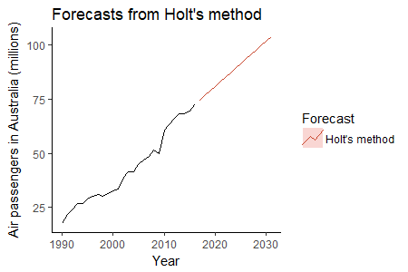
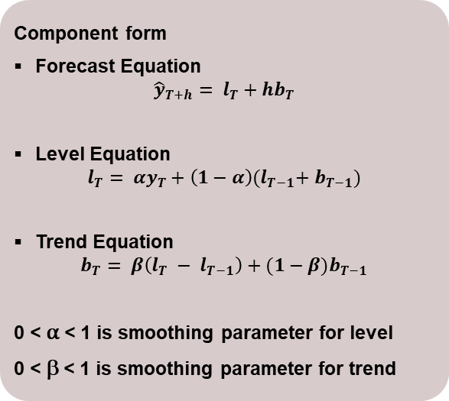
HOLT’S METHOD
Holt’s Linear Trend Method
Used when time series has trend into it
Two parameter are estimated – one for trend and another for level
Component form
Forecast Equation
$${\hat{y}}_{T+h}= l_{T}+hb_{T}$$
Level Equation
$$l_{T}= αy_{T}+\left(1−α\right){(l}_{T−1}+ b_{T−1})$$
Trend Equation
$$b_{T}= β\left(l_{T} − l_{T−1}\right)+(1−β)b_{T−1}$$
0 < α < 1 is smoothing parameter for level
0 < β < 1 is smoothing parameter for trend
Issues with model
Forecast keeps on increasing or decreasing indefinitely
Method tends to over forecast for longer forecast horizon
EXPONENTIAL SMOOTHING

Slide 11
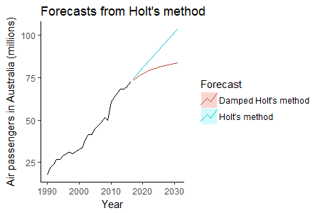
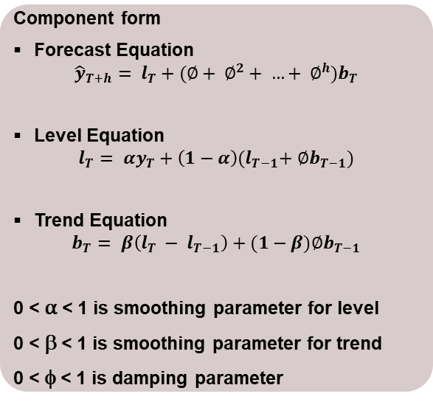
HOLT’S METHOD
Holt’s Damped Trend Method
Another parameter is introduced to dampen the trend over time
Three parameter are estimated – one for trend, second for level and third for damping the trend
Component form
Forecast Equation
$${\hat{y}}_{T+h}= l_{T}+(∅+ ∅^{2}+ …+ ∅^{h})b_{T}$$
Level Equation
$$l_{T}= αy_{T}+\left(1−α\right){(l}_{T−1}+ ∅b_{T−1})$$
Trend Equation
$$b_{T}= β\left(l_{T} − l_{T−1}\right)+(1−β){∅b}_{T−1}$$
0 < α < 1 is smoothing parameter for level
0 < β < 1 is smoothing parameter for trend
0 < φ < 1 is damping parameter
Damping parameter equal to 1 leads to Holt’s linear trend method
Typically value of damping parameter is kept between 0.8 to 0.98
EXPONENTIAL SMOOTHING

Slide 12
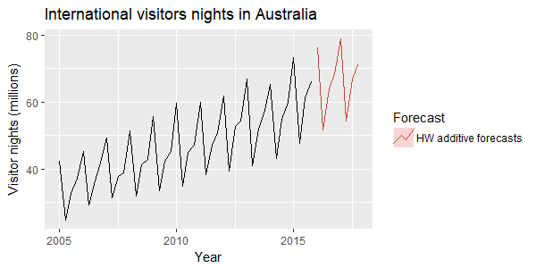
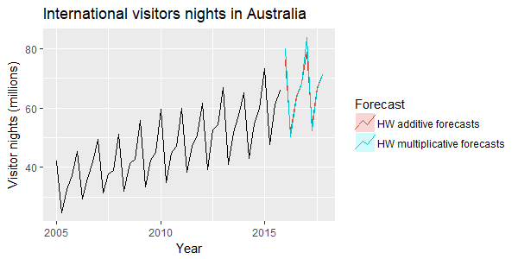
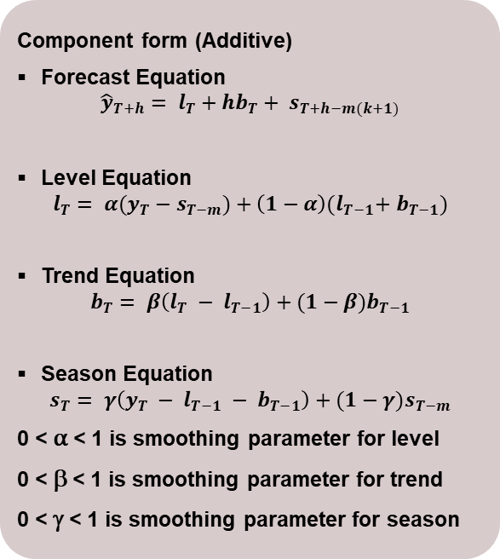
HOLT WINTER’S METHOD
Holt Winter’s Method
Used to handle seasonality as well along with trend in the time series
Three parameter are estimated – one for trend, second for level and third for seasonality
Component form (Additive)
Forecast Equation
$${\hat{y}}_{T+h}= l_{T}+hb_{T}+ s_{T+h−m(k+1)}$$
Level Equation
$$l_{T}= α{(y}_{T} − s_{T−m})+\left(1−α\right){(l}_{T−1}+ b_{T−1})$$
Trend Equation
$$b_{T}= β\left(l_{T} − l_{T−1}\right)+(1−β)b_{T−1}$$
Season Equation
$$s_{T}= γ\left(y_{T} − l_{T−1} − b_{T−1}\right)+(1−γ)s_{T−m}$$
0 < α < 1 is smoothing parameter for level
0 < β < 1 is smoothing parameter for trend
0 < γ < 1 is smoothing parameter for season
If seasonality is multiplicative, multiplicative form of HW should be used
EXPONENTIAL SMOOTHING

Slide 13
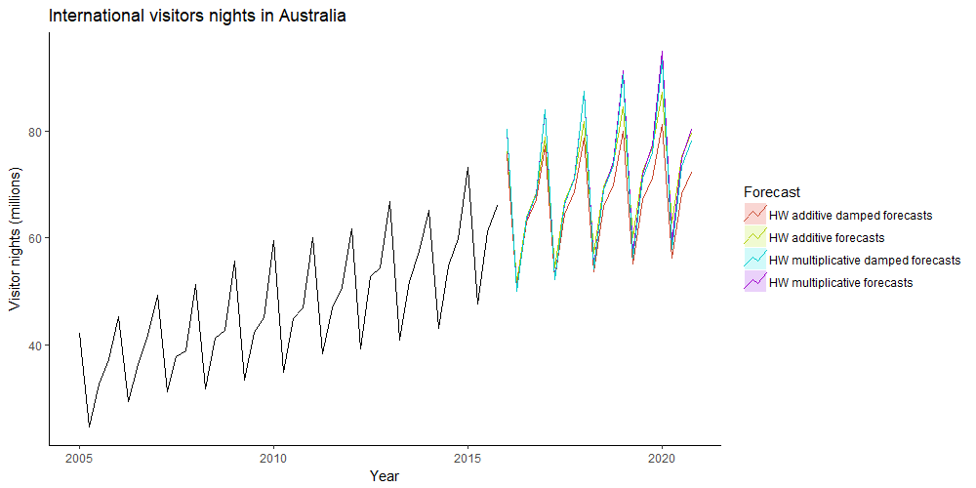
HOLT WINTER’S METHOD
Damping is also possible for both additive and multiplicative HW method
EXPONENTIAL SMOOTHING

Slide 14
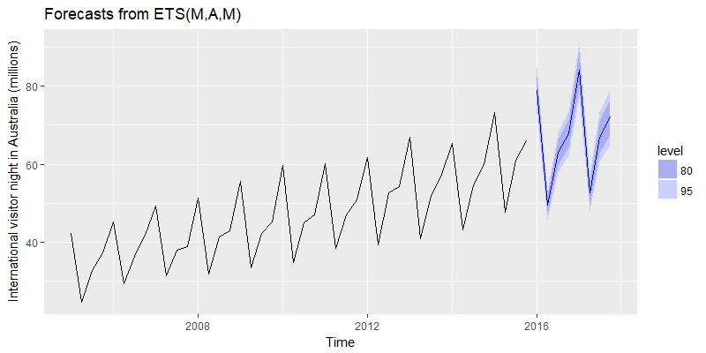
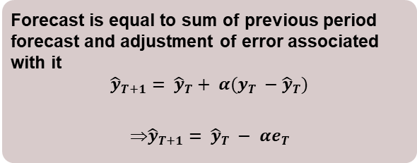
INNOVATIONS – EXPONENTIAL SMOOTHING MODEL
ETS (Error, Trend, Seasonal) Model
These provide prediction intervals along with point forecasts
Errors could be additive as well as multiplicative
Error - Additive |  | Seasonality
 |  | N | A | M
Trend | N | NN | NA | NM
 | A | AN | AA | AM
 | A_{d} | A_{d}N | A_{d}A | A_{d}M
Forecast is equal to sum of previous period forecast and adjustment of error associated with it
$${\hat{y}}_{T+1}= {\hat{y}}_{T}+ α(y_{T} −{\hat{y}}_{T})$$
$${\hat{y}}_{T+1}= {\hat{y}}_{T} − αe_{T}$$
Error - Multiplicative |  | Seasonality
 |  | N | A | M
Trend | N | NN | NA | NM
 | A | AN | AA | AM
 | A_{d} | A_{d}N | A_{d}A | A_{d}M
AIC, AIC_{C}, BIC values can be used for model selection
ETS in R (forecast package) estimates all the parameters and not the forecast directly
The parameters estimated can be used to forecast using ‘forecast()’ function
EXPONENTIAL SMOOTHING

Slide 15
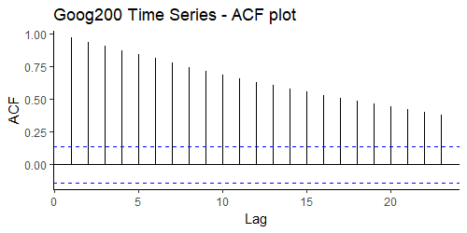
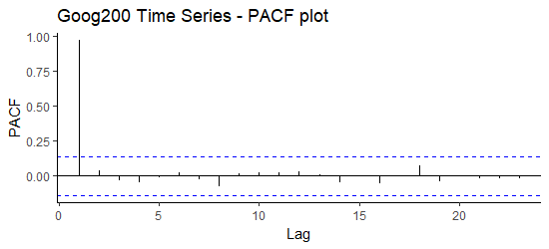
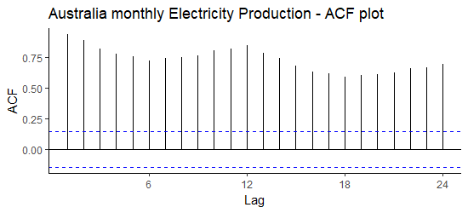
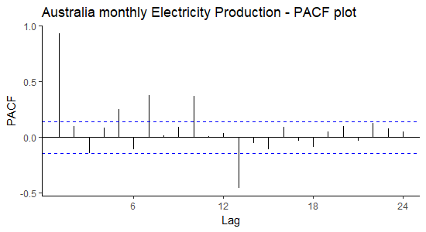
ACF AND PACF PLOT
Autocorrelation
It is measure of linear relationship between current and lagged observation
Graphical representation of autocorrelation coefficient is called ACF or correlogram
Partial Autocorrelation
It is measure of correlation between current and lagged observation by excluding influence of interim observations
Graphical representation of partial autocorrelation coefficient is called PACF
Example
Example
For series with trend only, ACF will gradually move towards zero value
For series with trend only, PACF will suddenly drop to zero value
For series with trend and seasonality, peaks will be observed at seasonal lag – more like waves
For series with trend and seasonality, PACF will show peaks at seasonal lags
ARIMA MODEL

Slide 16
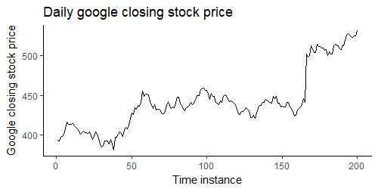
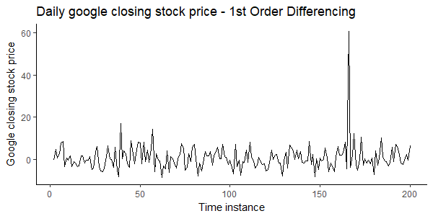
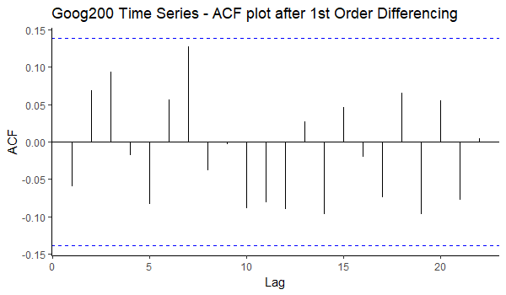
MAKING TIME SERIES STATIONARY
Stationary Time Series
A stationary time series doesn’t have any predictable pattern in long term
Note that cycles are aperiodic and hence, time series with cycles but no trend and seasonality will be considered as stationary
Differencing
Differencing helps in stabilizing the mean of time series by removing changes in level of the time series
This in turn leads to removal of trend and seasonality from the data
Non-Stationary to
Stationary
Box test can be run to identify if original or transformed series is stationary (null hypothesis is of time series being stationary)
Second order differencing, seasonal differencing can also be done
Differencing can also be done post log transformation
Non-Stationary Time Series
Non-stationarity can be validated from ACF plot
Time Series post First Order Differencing
ACF of First Order Differenced Time Series
ARIMA MODEL

Slide 17
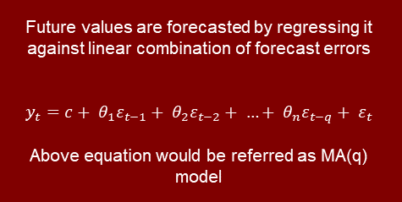
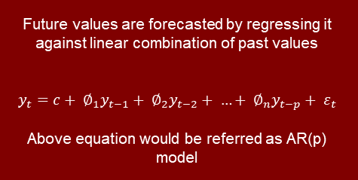
AUTO REGRESSIVE INTEGRATED MOVING AVERAGE
ARIMA
Auto Regressive Model
Integration
Moving Average Model
Future values are forecasted by regressing it against linear combination of past values
$$y_{t}=c+ ∅_{1}y_{t−1}+ ∅_{2}y_{t−2}+ …+ ∅_{n}y_{t−p}+ ε_{t}$$
Above equation would be referred as AR(p) model
Opposite of differencing
Future values are forecasted by regressing it against linear combination of forecast errors
$$y_{t}=c+ θ_{1}ε_{t−1}+ θ_{2}ε_{t−2}+ …+ θ_{n}ε_{t−q}+ ε_{t}$$
Above equation would be referred as MA(q) model
Expressing AR(p) as MA(∞) and MA(q) as AR(∞) is called invertibility of the model; this is an important property of ARIMA model along with stationarity
Value of p and q can be identified using ACF and PACF plots
For an ARIMA(p,d,0) model, ACF and PACF plots of differenced data would show:
ACF exponentially decaying or sinusoidal
Significant spike at lag p in the PACF, but non beyond p
For an ARIMA(0,d,q) model, ACF and PACF plots of differenced data would show:
PACF exponentially decaying or sinusoidal
Significant spike at lag q in the ACF, but non beyond q
If both p and q are positive, then plots don’t help in finding value of p and q
ARIMA MODEL

Slide 18
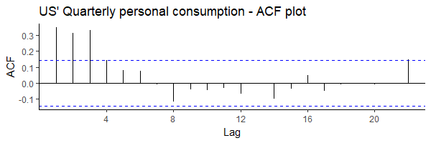
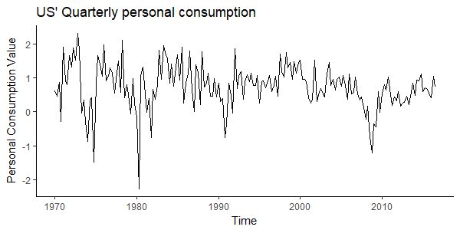
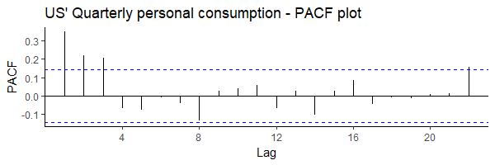
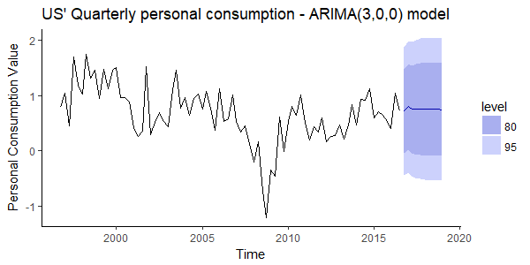

NON-SEASONAL ARIMA MODEL
Looks like ARIMA(3,0,0) model
AIC = 340.3 (Better Model)
AIC = 342.3
ARIMA MODEL

Slide 19
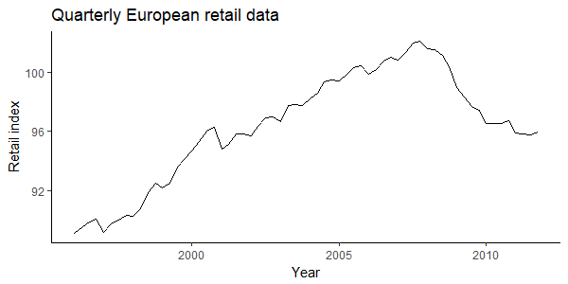
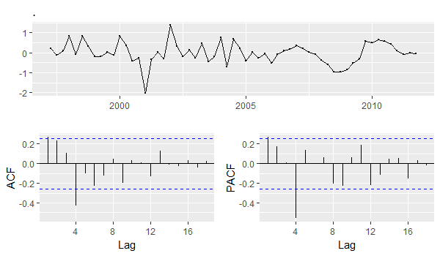
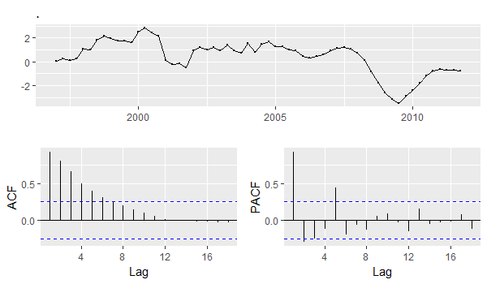
Seasonal ARIMA Model
Non Seasonal Part of the Model
(p, d, q)
Seasonal Part of the Model
(P, D, Q)_{m}
(p, d, q) are estimated using ACF and PACF plots as discussed previously
(P, D, Q) are estimated by observing peaks at the seasonal lags in ACF and PACF plots. For e.g. ARIMA(0,0,0)(0,0,1)₁₂ model will show:
A spike at lag 12 of the ACF plot but no other significant peaks
Exponential decay in seasonal lags of PACF plot
Data with trend and seasonality
Differencing Seasonal Lag Differenced data
Stationary after differencing the seasonal lag difference
Differencing Seasonal Lag
With peak at lag of 1 in ACF plot, it can be assumed as MA(1) non-seasonal model whereas peak at lag 4 suggests MA(1) seasonal model
Therefore, the model could be ARIMA(0,1,1)(0,1,1)₄
Taking PACF plot as reference, ARIMA(1,1,0)(1,1,0)₄ can also be created
Non-Stationary after seasonal differencing
ARIMA MODEL

Slide 20
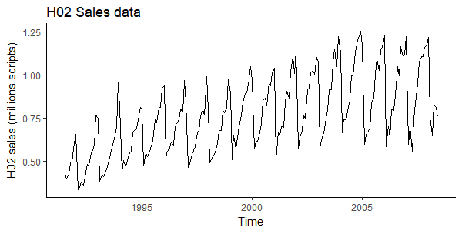
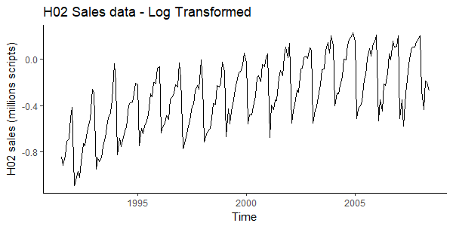
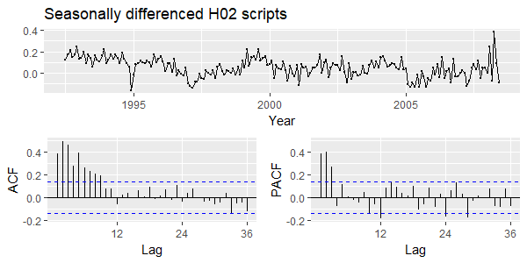
SEASONAL ARIMA MODEL
1
2
Data with trend and multiplicative seasonality
Log transformation to make seasonality consistent
3
PACF plot has peaks at seasonal lags of 12, 24; hence, a seasonal AR(1) model can be created
PACF plot also has peaks at 1, 2 and 3; hence, a non-seasonal AR(3) model can be created
Nothing is coming out of ACF plot
Therefore, creating ARIMA(3,0,0)(1,1,0)₁₂ model
Differencing logged data at seasonal lag of 12
ARIMA MODEL

Slide 21
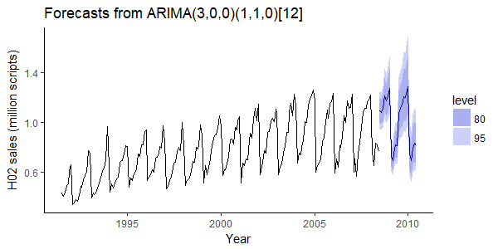
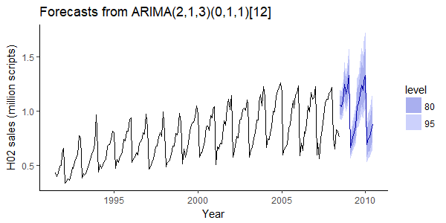
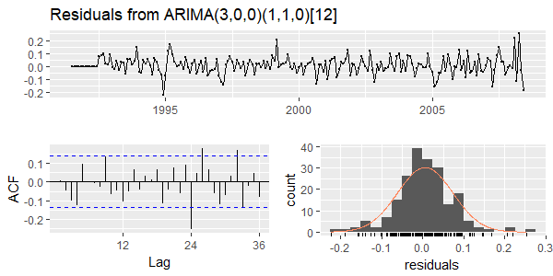
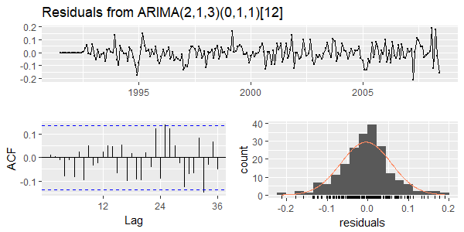
SEASONAL ARIMA MODEL
Seasonal ARIMA based on observations made from ACF and PACF plot
AIC = -464.48
Seasonal ARIMA using ‘auto.arima’ function in R
AIC = -486.99
Observations to be made
1)Time Series residuals look like white noise; 2)NO autocorrelation in residuals as per ACF plot; 3)Residuals follow bell curve
ARIMA MODEL

Slide 22
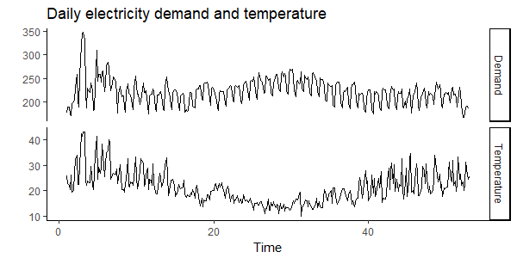
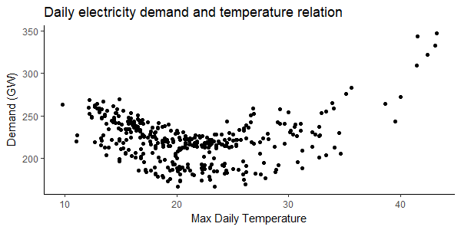
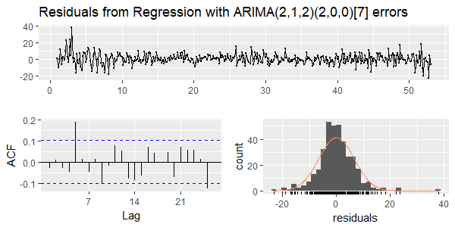
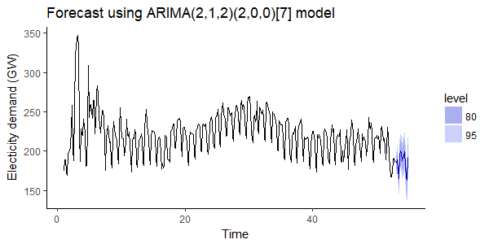
ARIMAX / DYNAMIC TIME SERIES MODEL
ARIMAX is the extended version of ARIMA model which also includes external regressor into the model
Daily electricity demand and max temperature time series
Quadratic relationship b/w Demand and temperature
Future values of independent variables are required to get the forecast; these can also be modeled separately
Assessing the model fit
Forecast for next 14 weeks
ARIMAX MODEL

Slide 23



CROSTON MODEL
Application
Croston Decomposition
Forecasting Model
Extensively used to model the intermittent demand (multiple zero values) time series
Demand Series (q) – Series with non-zeroes value
Inter-Arrival Time Series (a) – Series with periods between non-zero values
Simple exponential smoothening (SES) is done for q and a both
$${\hat{y}}_{T+h}= \frac{q_{j+1}}{a_{j+1}}$$
j is the time for last observed positive value
Year | Jan | Feb | Mar | Apr | May | Jun | Jul | Aug | Sep | Oct | Nov | Dec
1 | 0 | 2 | 0 | 1 | 0 | 11 | 0 | 0 | 0 | 0 | 2 | 0
2 | 6 | 3 | 0 | 0 | 0 | 0 | 0 | 7 | 0 | 0 | 0 | 0
3 | 0 | 0 | 0 | 3 | 1 | 0 | 0 | 1 | 0 | 1 | 0 | 0
Croston Decomposition into Demand and Inter-arrival time series
Croston model
i | 1 | 2 | 3 | 4 | 5 | 6 | 7 | 8 | 9 | 10 | 11
q | 2 | 1 | 11 | 2 | 6 | 3 | 7 | 3 | 1 | 1 | 1
a | 2 | 2 | 2 | 5 | 2 | 1 | 6 | 8 | 1 | 3 | 2
Prediction intervals are not generated in the Croston method
Doesn’t give point forecast; forecast value is average forecast for the period
CROSTON MODEL

Slide 24




MODEL FORECAST ACCURACY ASSESSMENT
Forecast error IS NOT same as residuals. Forecast error is calculated on test dataset whereas residuals are calculated on training dataset
$$e_{T+h}= y_{T+h} − {\hat{y}}_{T+h}$$
Typically used accuracy metrics
Root Mean Squared Error
(RMSE)
Mean Absolute Error
(MAE)
Mean Absolute Percentage Error
(MAPE)
Mean Absolute Scaled Error
(MASE)
$$\sqrt{mean(e_{t}^{2})}$$
Difficult to calculate and interpret
Forecast method minimizing RMSE will lead to forecasts of mean
$$mean\left|e_{t}\right|$$
Easy to calculate and interpret
Forecast method minimizing MAE will lead to forecasts of median
$$mean\left|p_{t}\right|$$
Suffers from being equal to infinite or undefined for y_{t} = 0 or very small I value
$$mean\left|\frac{e_{t}}{Training MAE}\right|$$
Extended version of MAPE
Value greater than 1 means forecast is better than naïve forecast and vice versa
Can’t be used when multiple time series are available with different units as these metrics preserve the metric information
Can be used when multiple time series are available with different units
At times different accuracy metrics may show different models to be best. In such a scenarios, select model based on business context
MODEL SELECTION

Slide 25
MODEL FORECAST ACCURACY ASSESSMENT
Traditional Test and Train Sampling
Segregate data into test and train sample
Typically the split between train and test is taken as 80-20% or 75-25% of observations respectively
Model is trained on full training dataset and forecast accuracy is measured on test dataset
Train Sample
(In-Sample)
Test Sample
(Held-out Sample)
Time Series Cross Validation
Multiple test sets are created with one observation each
All the observations before the test observation forms the training set
Model is trained on the training set
Model forecast accuracy is measured by averaging value over different test sets
The accuracy values generated are more robust to be communicated
A good way to choose the best forecasting model is to find the model with the smallest RMSE computed using time series cross-validation
MODEL SELECTION

Slide 26

REGRESSION MODELING

Slide 27
Regression: Explaining dependent variable through linear / non-linear combination of independent variables
Dependent Variable: Variable which needs to be predicted. Also called as ‘response’ variable
Independent Variable: Variables used to explain dependent variable. Also called as predictor variable
Pearson’s R Squared: Coefficient of determination – talks about the fit of the model as compared to actual values
Best Fit: The regression model line which best fits the actual data
Ordinary Least Square: Famously abbreviated as OLS. Used for estimation of regression parameters by minimizing SSE
Multicollinearity: Correlation among various independent variables under analysis
Maximum Likelihood: Famously abbreviated as MLE. Used for estimation of regression parameters by maximizing the likelihood that process described by model produced data observed actually
SOME KEYWORDS

Slide 28








Describing dependent variable as linear combination of independent variable
$$\hat{Y}=\sum_{i=1}^{n}{β_{i} ∗ X_{i} +c+ ε}$$
Y = Dependent Variable; X = Independent Variable; β = Linear combination coefficient; c = Intercept; ε = Error
Regression Line
Sum of Squares of Error (SSE)
$$SSE= \sum_{i=1}^{n}{e_{i}^{2}}$$
Measure of unexplained variation
Dependent Variable (Y)
Dependent Variable (Y)
ΔY
$$Slope \left(β\right)= \frac{∆Y}{∆X}$$
Sum of Squares Regression (SSR)
$$SSR= \sum_{i=1}^{n}{{\left({\hat{y}}_{i} − \overline{y}\right)}^{2}}$$
Measure of explained variation
ΔX
Population Mean
Residual
$$e_{i}=y_{i}−{\hat{y}}_{i}$$
Total Sum of Squares
$$SST=SSR+SSE$$
Measure of total variation in y
Intercept (c)
Independent Variable (X)
Independent Variable (X)
Coefficient of Determination(R²): Proportion of SST that is explained by the regression model (SSR)
$$R^{2}=\frac{SSR}{SST}=\frac{SSR}{SSR+SSE}$$
Value of R² ranges between 0 and 1; higher the value of R² better the fit
Standard Error of Regression Model
$$Standard Error= \sqrt{\frac{SSE}{n−k}}$$
n = # observation; k = # variables
LINEAR REGRESSION

Slide 29

ASSUMPTIONS OF LINEAR REGRESSION MODEL
No Multicollinearity
No correlation in residuals
Homoscedasticity
Normal distribution of error
Independent variables shouldn’t be correlated to each other
Absence of autocorrelation in error terms
Error terms having constant variance
Bell curve looking histogram of error
Data: Iris
Sample Problem: Identifying variables on which length of sepal depends
Dependent Variable: Sepal.Length
Independent Variable: Petal.Length, Petal.Width and Sepal.Width
Correlation Matrix Plot
Correlation Matrix
 | Sepal.Length | Sepal.Width | Petal.Length | Petal.Width
Sepal.Length | 100% | -12% | 87% | 82%
Sepal.Width |  | 100% | -43% | -37%
Petal.Length |  |  | 100% | 96%
Petal.Width |  |  |  | 100%
Petal Width and Petal Length attributes are highly correlated to each other
Only one of the two attributes should be kept in the model
LINEAR REGRESSION

Slide 30



UNDERSTANDING LINEAR REGRESSION OUTPUT
1
1
Sepal Length is regressed against Sepal Width & Petal Length
2
2
Summary statistics of residual distribution
3
4
5
3
Estimate values for intercept (c) and slope (β)
4
Standard error associated with the estimates. Multicollinearity leads to increase in error associated with the estimates. Variance Inflation Factor (VIF) can be used to understand increase in variance because of correlated independent variables in the model
6
5
6
Significance Test: The null hypothesis is that there is no linear relationship between independent and dependent variable i.e. slope is equal to zero
T-Test (Student’s T-Test): It compares averages of two variables and implies how different the two values are from each other and could it have happened by chance
$$T Statistics = \frac{{\hat{β}}_{i} − β_{i|null}}{se({\hat{β}}_{i})}$$
P-value: It is probability of a statistical model, given the null hypothesis is true. Value lies between 0% and 100%. As lower p-value implies results to be significance which leads to rejection of null hypothesis. Typically used significance level is 0.05
Degrees of Freedom: It is the number of observations which are ‘free’ to vary while calculating / estimating a statistical parameter.
$$Degree of Freedom=n −k$$
Where n = # observations and k = statistical parameters to be estimated
R-Squared: Refer slide #27 for definition. One of the problems with R-squared is that it keeps on increasing with number of independent variables in the model. Consequently model with more term seems to be more better.
Adjusted R-squared: The adjusted R-squared increases only if the new term improves the model more than would be expected by chance. It decreases when a predictor improves the model by less than expected by chance.
F-Statistics: Used to identify significance of overall model. The null hypothesis being our model is same as intercept-only model. Higher F statistics implies significant regression model
$$F Statistics=\frac{SSR/(k−1)}{SSE/(n−k)}$$
P-value is calculated corresponding to F Statistics for significance test.
LINEAR REGRESSION

Slide 31




MODEL DIAGNOSTICS (MAPE – 4.5%)
Residuals fall on the diagonal line, indicating normal distribution of error
Residuals follow the bell curve (though outlier on left tail)
Residual can be called as ‘Homoscedastic’
Actual and fitted values fall on the line
LINEAR REGRESSION

Slide 32



GENERALIZED LINEAR MODEL
Generalized Linear Model (GLM) are an extension of linear model framework, which includes dependent variable which are non-normal also.
Characteristics of a GLM model are:
These models comprise a linear combination of input features
The mean of the response variable is related to the linear combination of input features via a link function
The response variable is considered to have an underlying probability distribution belonging to the family of exponential distributions such as binomial distribution, Poisson distribution, or Gaussian distribution
Logistic Regression belongs to the family of generalized linear models. It is a binary classification algorithm when the response variable is dichotomous (1 or 0)
$$ln\left(\frac{p}{1−p}\right)= β_{0}+ β_{1}x_{1}+ …+ β_{n}x_{n}$$
Here p is the probability of success of the event
Random Component – Refers to probability distribution of response variable
Probability distribution is assumed to be Binary distribution
Systematic Component – Specifies the linear combination of predictor variables
$$β_{0}+ β_{1}x_{1}+ …+ β_{n}x_{n}$$
The independent variables can be transformed as done in typical linear regression
Link Function – Specifies link between Random and Systematic component
$$logit\left(p\right)=ln⁡(\frac{p}{1−p})$$
Above function is called as logit / sigmoid / log odds function
Maximum Likelihood Estimation is used to get best ‘beta’ coefficients
LOGISTIC REGRESSION

Slide 33




INTERPRETING BETA ESTIMATES
Data: mtcars
Sample Problem: Predicting whether motor engine is ‘vs’ (v-shaped (0) or straight(1)) using ‘mpg’ (miles / gallon) and ‘am’ (Transmission(0 = automatic and 1 = manual)) predictor variables
Dependent Variable: vs
Independent Variable: am, mpg
Interpreting ‘Beta’ Estimate
Frequency table for ‘vs’ response variable (Y):
$$p\left(Y=1\right)=\frac{14}{32}=0.4375$$
$$\log\left(\frac{p}{1−p}\right)=\log\left(\frac{0.4375}{1−0.4375}\right)=−0.2513144$$
Therefore, intercept estimate implies log odds of having engine type as straight for whole population of interest
Intercept-only Model - NO predictor variables
V-shaped (0) | Straight(1)
18 | 14
Interpreting ‘Beta’ Estimate
The intercept here is log odds ratio for a car having ‘mpg’ as 0 and having straight shaped engine. The probability of this can be identified as:
$$\exp\left(−8.8331\right)=0.000145$$
This probability is extremely low as least mpg value in data is 10.4. Therefore, this probability corresponds to hypothetical zero mpg value
Beta estimate for mpg attribute can be interpreted as one unit change in mpg will lead to expected change in log odds of 0.4304
One CONTINUOUS predictor variable
LOGISTIC REGRESSION

Slide 34


INTERPRETING BETA ESTIMATES
Interpreting ‘Beta’ Estimate
Frequency table for ‘vs’ response variable (Y) with ‘am’(X):
Odds of am(0) having vs(1) is 7 to 12 (7/12) and odds for am(1) having vs(1) is 7 to 6 (7/6).
Now, the intercept is log odds of Automatic transmission having straight engine, i.e.
$$log\left(\frac{7}{12}\right)=−0.5389965$$
The ratio of odds for am(1) having vs(1) to am(0) having vs(1) can be given as:
$$\frac{7/6}{7/{12}}=2$$
Therefore, the estimate of ‘am’ is log of odds ratio between Manual(1) and Automatic(0) having Straight shape (1) engine
$$\log\left(2\right)=0.6931472$$
 | Automatic(0) | Manual(1) | Total
V-shaped (0) | 12 | 6 | 18
Straight(1) | 7 | 7 | 14
Total | 19 | 13 | 32
One DICHOTOMOUS predictor variables
LOGISTIC REGRESSION

Slide 35



UNDERSTANDING LOGISTIC REGRESSION OUTPUT
1
1
Predicting ‘vs’ through ‘mpg’ and ‘am’. As can be seen probability distribution used is binomial and link function is logit
2
2
Deviance: It is the metric used to estimate goodness of fit for GLM models. It is given as
$$D^{2}=2\left\{\ln\left[L_{s}\left(\hat{β}\right)\right] −ln⁡[L_{m}(\hat{β})]\right\}$$
Where part left to minus sign is max. loglikelihood of fitted model and part to the right of minus sign is max. loglikelihood of saturated model (represents the largest model we can fit and leads to perfect prediction of the outcome of interest)
Null Deviance: When the model is intercept-only model. Degree of Freedom (DF) is n-1
Residual Deviance: When model has predictors of interest in it. DF is n-k-1
Lower the Residual Deviance as compared to Null Deviance, better the model
3
4
2
5
3
4
5
AIC: Analogous to Adjusted R-Squared as calculated in linear regression. Helps in evaluating multiple models while selecting the best fit
Fisher Scoring: Fisher scoring algorithm is a derivative of Newton-Raphson’s to solve maximum likelihood estimation problem to solve statistical parameter. Fisher Scoring Iteration tells number of iterations optimization ran before getting the final model. Not much can be inferred from this parameter apart from the fact that model converged
Estimate: Each estimate can be interpreted as change in log odds of getting Y=1 by 1 unit change in corresponding predictor keeping other predictors as constant at certain value.
For e.g. Odds for engine to be straight shape for a manual transmission (manual = 1) over odds of engine being straight shaped for an automatic transmission (automatic = 0) keeping mileage as constant is exp(0.6809) = 1.97 That is odds for manual transmission are 97% higher than automatic one keeping miles / gallon of the car as constant
Std. Error: Standard error associated with the beta estimates
Significance Test: The null hypothesis is that there is no relationship between independent and dependent variable i.e. beta is equal to zero
z value: z-value is calculated as:
$$z statistics= \frac{β_{i}}{se(β_{i})}$$
Higher value of z score (be it positive of negative) will lead to significance of. p-value is calculated further to reject / accept the null hypothesis.
LOGISTIC REGRESSION

Slide 36


MODEL VALIDATION
Confusion Matrix | 1 (Predicted) | 0 (Predicted)
1 (Actual) | True Positive (TP) | False Negative (FN)
0 (Actual) | False Positive (FP) | True Negative (TN)
Receiver Operator Characteristic (ROC) Curve
Accuracy: Measure of overall prediction accuracy of the model
$$Accuracy= \frac{TP+TN}{TP+TN+FP+FN}$$
True Positive Rate (TPR): Measure of how many positive values out of all positives values have been correctly predicted. Also called as Sensitivity
$$TPR= \frac{TP}{TP+FN}$$
False Positive Rate (FPR): Measure of how many negative values of all negative values been incorrectly predicted
$$FPR= \frac{FP}{FP+TN}$$
True Negative Rate (TNR): Measure of how many negative values of all negative values have been correctly predicted. Also called as Specificity
$$TNR= \frac{TN}{TN+FP}$$
False Negative Rate (FNR): Measure of how many positive values of all positive values been incorrectly predicted
$$FNR= \frac{FN}{FN+TP}$$
Precision: Measure of how many values, of all predicted positives are actually positive
$$Precision= \frac{TP}{TP+FP}$$
F Score: It is harmonic mean of precision and sensitivity. Higher the value of F score, better the model
$$F Score= \frac{2 (Sensitivity ∗Precision)}{Sensitivity+Precision}$$
ROC determines the accuracy of a classification model at a user defined threshold value
It determines the model's accuracy using Area Under Curve (AUC)
The area under the curve (AUC), also referred to as index of accuracy (A) or concordant index, represents the performance of the ROC curve
Higher the area, better the model
ROC is plotted between True Positive Rate (Y axis) and False Positive Rate (X Axis)
In above plot, aim is to push the red curve toward 1 (left corner) and maximize the area under curve
The yellow line represents the ROC curve at 0.5 threshold - At this point, sensitivity = specificity
LOGISTIC REGRESSION

Slide 37

MODEL VALIDATION
Things to look for model validation
Multicollinearity (for continuous variables using correlation matrix plot and VIF value for the model)
Linear relationship between logit and continuous variable
Influential point using Cook’s distance
ROC curve
AUC = 0.9
LOGISTIC REGRESSION

Slide 38

MODELING METHODS
Parametric Models
Non-Parametric Models
Relationship between dependent and independent variable IS presumed to be of certain form. E.g. linear regression, logistic regression etc.
Relationship between dependent and independent variable IS NOT presumed. E.g. MARS, GAM etc.
Multivariate Adaptive Regression Splines (MARS)
MARS is a non-parametric regression technique which can be understood as extension of linear models to model the non-linearities and interactions in the data
MARS fits a piecewise linear model where pieces can be distinguished by ‘knot’ or ‘hinges’
2 Basis Functions are associated with a knot, which can be given as
$$BF1=max⁡(0, X −Knot)$$
$$BF2=max⁡(0, Knot −X)$$
Regression Line
Dependent Variable (Y)
Fitting MARS model
Forward Pass (FP)
MARS starts with just a intercept (mean of the response variable)
At each step add a pair of basis function which leads to maximum decrease in SSE (called as greedy algorithm)
Above step continues until there is no further reduction in SSE or maximum number of terms are reached
Backward Pass (BP)
Forward pass will typically lead to overfitted model and hence, backward pass is used to prune the model
BP keeps on removing terms with least effectiveness until it finds best sub-model through Generalized Cross Validation algorithm (GCV)
Generalized Cross Validation
GCV is a form of regularization – i.e. it trades of good of fit with model complexity
Lower the value of GCV, better the model
Knot
Independent Variable (X)
MARS MODEL

Slide 39


BUILDING MARS MODEL
Data: trees
Sample Problem: Predicting volume of timber using girth and height of the tree
Dependent Variable: Volume
Independent Variable: Girth, Height
Multicollinearity of Independent Variable
Output of Model Fit
Cor Matrix | Volume | Girth | Height
Volume | 100% | 97% | 60%
Girth |  | 100% | 52%
Height |  |  | 100%
MARS MODEL

Slide 40

MODEL DIAGNOSTICS
MODEL DIAGNOSTICS PLOTS
GCV and GRsq are the metrics used for generalization of the model
It can be seen that initially Rsq and GRsq were almost similar but later GRsq decreased which was because of increased penalty due to more number of parameters
Model where GRsq had maximum value is the selected model – represented by dotted line
Number of parameters for even lower value of GRsq can also be identified from here
1
1
2
2
Cumulative Distribution graph shows cumulative distribution of absolute residuals
Median (50% vertical line) of the residual is around 2
It can be concluded that about 95% of the absolute residuals are slightly lesser than 5 units of actual value
3
4
3
Residuals should have constant variance for the homoscedasticity of the model
The same can be concluded from Residuals vs Fitted plot
4
Residuals can be concluded to be normally distributed (bell shaped) as most of the points are falling on the diagonal line
MARS MODEL

Slide 41



GENERALIZED ADDITIVE MODEL (GAM)
GAM is used to model the response variable by independent variables, which are in the form of some smooth functions. Mathematically it can represented as
$$g\left(E\left(y_{i}\right)\right)= β_{0}+ f_{1}\left(x_{i1}\right)+ f_{2}\left(x_{i2}\right)+ …+ f_{p}\left(x_{ip}\right)+ ε_{i}$$
$$y_{i} \sim Some Exponential Family Distribution$$
Here, y = response variable, x = independent variable, g = link function, f() = smooth function (non-parametric function) and ε = error
Pros:
Models non-linearity in the data using splines
Addresses multi-seasonal time series effectively
Complex interaction terms like ‘tensor product’ interaction can also be handled
Cons:
Overfitting in case smaller sample size of training dataset
Could be difficult to interpret from business perspective
GAM MODEL

Slide 42



PRINCIPAL COMPONENT ANALYSIS (PCA)
PCA is a dimensionality reduction technique used to identify set of dimensions which are orthogonal to each other and explain maximum variance in the data
Too many jargons! Let’s simplify this
VARIANCE
It is measure of variability or simply the spread of the data
$$var\left(x\right)= \frac{\sum{{\left(x_{i} − \overline{x}\right)}^{2}}}{N}$$
COVARIANCE
It is measure of extent to which two sets of ordered data move in same direction
$$cov\left(x,y\right)= \frac{\sum{(x_{i} − \overline{x})(y_{i} − \overline{y})}}{N}$$
EIGEN VALUE / VECTOR
If matrix A (n-by-n) is multiplied by a vector v(n-by-1), then v gets scaled by a parameter λ, observing following equation
$$A.= .$$
Here, ν = Eigen Vector and λ = Eigen value
Assuming data has 4 dimensions, covariance matrix can be written as:
OBJECTIVE OF THE PCA
 | a | b | c | d
a | cov(a,a) | cov(a,b) | cov(a,c) | cov(a,d)
b | cov(b,a) | cov(b,b) | cov(b,c) | cov(b,d)
c | cov(c,a) | cov(c,b) | cov(c,c) | cov(c,d)
d | cov(d,a) | cov(d,b) | cov(d,c) | cov(d,d)
Identify dimension which explain maximum variance in the data
Diagonal of the covariance matrix should have large values
The identified dimensions should be orthogonal i.e. no collinearity
Zero values off the diagonal elements
 | a | b | c | d
a | var(a) | cov(a,b) | cov(a,c) | cov(a,d)
b | cov(b,a) | var(b) | cov(b,c) | cov(b,d)
c | cov(c,a) | cov(c,b) | `var(c) | cov(c,d)
d | cov(d,a) | cov(d,b) | cov(d,c) | var(d)
Matrix with above enlisted properties is called as diagonal matrix. The process of transforming a matrix into a diagonal matrix is called as diagonalization
If P is the eigen vector of C_{x} (covariance matrix of original dataset X), then C_{y} (covariance matrix of transformed dataset Y) will be a diagonal matrix (refer bibliography for proof)
LATENT VARIABLE MODEL

Slide 43




INTUITION BEHIND PRINCIPAL COMPONENT ANALYSIS (PCA)
Reducing 2 dimensional data into 1 dimension
Principal Axis
Original data point
Projected data point
Projection Error
Higher projection error
Less Spread i.e. Less variance
Lower projection error
Higher Spread i.e. Higher variance
The line which gives least projection error and has more spread of data is selected as “Principal Axis”
The new data points on the derived dimension i.e. principle axis are the projected data points (red dots)
The new dimension is called as “Latent Variable” and the plane so formed by latent variables is called as “Hyperplane”
LATENT VARIABLE MODEL

Slide 44
PRINCIPLE COMPONENT REGRESSION (PCR)
Steps Involved
Normalize the independent variables (i.e. mean of 0 and standard deviation of 1)
Run PCA to identify the Principal Components
Regress Principal Components against dependent variables
Pros
Cons
Misconception
Dimensionality Reduction
Difficulty in explaining effect of original variables
PCR being a feature selection technique – NO, it’s not true as principal components are linear combination of original independent variables
Avoiding Multicollinearity
Hyperplane not aligned to direction of dependent variable, can lead to higher error
Avoid Overfitting
LATENT VARIABLE MODEL

Slide 45

PRINCIPLE COMPONENT REGRESSION (PCR)
Data: Hitters
Sample Problem: Predict salary of baseball players using available 19 variables
Dependent Variable: Salary
Independent Variable: All 19 variables
Model Summary
1
2
1
Cross Validation RMSE as more and more components are included in the model
2
Percentage variance of dependent and independent variable explained by different number of components
LATENT VARIABLE MODEL

Slide 46

PRINCIPLE COMPONENT REGRESSION (PCR)
Selecting Number of Components
Having all 16 components in the model doesn’t make sense as that would be same as having all independent variable in the model
Cross validation error is least for 4 components and R-squared is maximum for the same value
A little higher than 90% of variance gets explained if 5 components are considered with RMSE and MSE similar as for 6 components
Let’s build model by considering only 5 components in the model
Similar subjectivity while interpreting the model summary would be required to identify desired number of components to be considered
LATENT VARIABLE MODEL

Slide 47


PARTIAL LEAST SQUARES (PLS)
Steps Involved
Normalize the independent variables (i.e. mean of 0 and standard deviation of 1)
Identify components for X and that for Y
Reconcile the components of X and Y such that covariance of X and Y is maximum
Model Summary
LATENT VARIABLE MODEL

Slide 48

PARTIAL LEAST SQUARES (PLS)
Selecting Number of Components
Having all 16 components in the model doesn’t make sense as that would be same as having all independent variable in the model
Cross validation error is least for 9 components and R-squared is maximum for the same value
~97% of variance gets explained if 9 components are considered with RMSE and MSE similar as for 9 components
Let’s build model by considering only 9 components in the model
PLS model is 2% more accurate as compared to PCR (Overall model accuracy is not good at all - Work on it for your practice)
LATENT VARIABLE MODEL

Slide 49





HIERARCHICAL MODEL
Hierarchical model are the statistical models where value of statistical parameter varies at multiple levels. These are also called as Multilevel model, nested data model, mixed effect model, random effect models etc.
Level 1 - Companies
Level 2 - Department
Dep1
Dep2
Dep3
Dep1
Dep2
Dep3
Dep1
Dep2
Dep3
Dep1
Dep2
Dep3
Level 3 - Employee
From above example, behavior of Dep1 employees won’t be same as Dep2 employees within same the company and likewise behavior of same across companies would be different. Therefore, to model the individual group’s behavior more accurately, Hierarchical Models are required
HIERARCHICAL MODEL

Slide 50


Mixed Effect Model
Fixed Effect (FE)
Random Effect (RE)
These considered as constants within the population. Hence, FE conveys systematic and structural differences in response. Typical linear regression is a fixed effect model as a definitive (fixed) relationship between dependent and independent variables is modeled
These are considered as stochastic and hence, RE convey stochastic differences between groups or clusters of information. For e.g. sales captured from different cities could have random effect at city level because of demographics of the city
$$Dependent Varaible \sim Independent.Varaibles+Independent.Variables | Subject.Variable$$
Here, Subject Variable = Categorical variable available in data which signifies hierarchy of the data
Defining Model Form and Expected Outcome
Random Effect
Effect type | # of Intercept Estimates | # of Slope Estimates
Fixed Effect | 1 | 1 (X1)
Random Effect | 10 (L1) | 10 (L1)
 | 50 (10 x 5 i.e. L2 within L1) | 50 (10 x 5 i.e. L2 within L1)
$$Y \sim 1+X1+(1+X1|L1/L2)$$
Model Output
Fixed Effect
Y = Dependent Variable
X1 = Independent Variable
L1 = Higher hierarchy level
(assuming10 groups)
L2 = Lower hierarchy level
(assuming 5 groups per L1 group)
HIERARCHICAL MODEL

Slide 51



MIXED EFFECT MODEL
Data: Iris
Sample Problem: Predicting Sepal Length using Petal Length for various species
Dependent Variable: Sepal.Length
Independent Variable: Petal.Length
Subject Variable: Species
Two clusters of data can be distinctly identified, hence, maybe building two model is separately is good enough
Have you looked into all aspects of data? Is there some sort of group already available in data?
Each of the species shows very different behavior, hence, it is better to build different model for each of them
HIERARCHICAL MODEL

Slide 52

INTERPRETING MODEL OUTPUT
1
1
MLE is used for parameter estimation. Satterthwaite approximation is used to estimate degree of freedom for mixed effect models
2
3
2
Fixed and random effect have slope and intercept estimate in model form.
Multiple control parameters can be passed for termination condition of optimizer used to run MLE
4
5
3
Maximum Likelihood estimation metrics. Refer to previous slides for definitions of each of the terms
4
Metrics for residual distribution from fitted model
6
7
5
Variance and standard deviation associated with random effect estimates. However, summary doesn’t give value of random effect coefficients. random.effects() function should be used to extract the same.
P value for random effect are also not given directly. Std error can be used to identify z score and guestimate the significance of estimate
6
Estimates for intercept and slope of fixed effect component of the model. Along with estimate values, error and significance test value are summarized. As can be seen here, the independent variable seems to be significant.
Net Estimate: The net estimate i.e. overall effect of independent variable can be calculated by adding up fixed and random effect component estimates. In R, coefficient() function can be used to get overall effect of a variable
7
Correlation matrix is also given for fixed effect component. The assumption around absence of multicollinearity in independent variable hold true for mixed model as well. Hence, always used correlation matrix to handle correlated variables
HIERARCHICAL MODEL

Slide 53

MODEL VALIDATION
Residual look normally distributed as all points fall on diagonal
Residual histogram looks like bell curve
Residuals have constant variance – no pattern can be seen - Homoscedastic
4. Residuals across subject variable are similar
5. Actual vs fitted line is falling almost on the diagonal line
6. Fit corresponding to different species as per mixed effect model
HIERARCHICAL MODEL

Slide 54

DECISION TREE MODELING

Slide 55




Machine Learning
Supervised
Un-Supervised
Reinforcement
Random Forest
What is Random Forest
Random Forest or Random Decision Forest is a method that operates by constructing multiple decision trees during training phase.
The Decision of majority of the trees is chosen by the random forest as the final decision.
Why Random Forest
No Overfitting
Usage of multiple trees for prediction reduces risk of overfitting
High Accuracy
Works efficiently and accurately on large data – good for Big data
Estimates Missing data
Can be extremely accurate even when some of the data is missing
DECISION TREE MODELING

Slide 56



DECISION TREE
Decision Tree uses a tree like graph to determine a course of action. Each branch of the tree represents a possible decision or business rule
Rule1 = T
Rule1 = F
Is Diameter >= 3cm
Example
FALSE
TRUE
Rule2 = T
Rule2 = F
Rule3 = T
Rule3 = F
Is color = Orange
TRUE
FALSE
Root Node
Terminal / Leaf Node
Courtesy: Simplilearn. Absolutely love this example
Splitting of Node takes place based on ‘information gain’ which is measure of decrease in ‘entropy / randomness’ available in the node. The splitting of data which leads to maximum information gain is used as reason for splitting. This is also know as splitting based on the ‘homogeneity’ of the node.
DECISION TREE MODELING

Slide 57






RANDOM FOREST
Tree 1
Tree 2
Tree 3
Is Diameter >= 3cm
Is color == Red
Is Diameter = 1cm
FALSE
TRUE
TRUE
FALSE
TRUE
FALSE
Based on training data
Is color = Orange
Is Shape = Circle
Grows in summer ?
TRUE
FALSE
FALSE
TRUE
TRUE
FALSE
Diameter = 3
Grows in Summer = Yes
Shape = Circle
O/p Tree 1
O/p Tree 2
O/p Tree 3
Test Dataset
Orange
Cherry
Orange
Based on majority of votes, the new shape would be predicted as Orange. This combining of trees to form a strong predictor is called as ‘Ensembling’. Therefore in a random forest, multiple decision trees are created and results from these trees are ensembled to give accurate predictions
Courtesy: Simplilearn
DECISION TREE MODELING

Slide 58

TREE BASED REGRESSION
Data: Boston
Sample Problem: Predicting median value of owner-occupied homes (medv) using available independent variables
Dependent Variable: medv
Independent Variable: All the variables available in data
Single Decision Tree
Bagging Decision Tree
Random Decision Forest
Boosted Decision Tree
DECISION TREE MODELING

Slide 59

SINGLE REGRESSION TREE
Output of Regression Tree
Root node shows total number of observations in the train dataset
Each node shows following:
Weighted average of the response variable
Total number of observation (n)
Percentage of observations as compared to whole training dataset (percentage value)
Below each node rule for splitting the node is provided which leads to maximum information gain / decrease in entropy. For classification tree this is measured using Gini Index and Entropy whereas for regression tree decrease in RSS is measure of reduction in entropy
Only 4 variables out of 13 variables have been considered to create the tree
Summation of observations in terminal nodes will lead to total number of observations in training dataset
To identify the depth at which tree should be pruned, one can use k-fold cross validation error. The number of leaves at which deviance is least should be used to avoid overfitting
Accuracy Metrics
ME | RMSE | MAE | MPE | MAPE
0.9729 | 8.2851 | 5.3652 | -4.3199 | 24.0975
DECISION TREE MODELING

Slide 60


BAGGING DECISION TREE
Bagging same as Random Forest grows multiple trees and runs Ensembling on top of it for accurate predictions. However, bagging always considers all the variables unlike RF for splitting of the node and hence, leads to correlated trees in presence of strong predictor
All variables are used for splitting of the node and total of 500 trees were grown
Accuracy Metrics (500 Trees)
ME | RMSE | MAE | MPE | MAPE
1.077 | 6.9226 | 4.3586 | -3.1309 | 20.0444
Selecting only 350 trees as error is least for the same
Accuracy Metrics (350 Trees)
ME | RMSE | MAE | MPE | MAPE
1.0905 | 6.8926 | 4.3226 | -3.1108 | 19.9127
Forest with lesser number of trees seems to be slightly more accurate than model with 500 trees
DECISION TREE MODELING

Slide 61


RANDOM DECISION FOREST
Only 7 variables are used at a time for splitting of the node
Accuracy Metrics (500 Trees)
ME | RMSE | MAE | MPE | MAPE
1.0102 | 6.8069 | 4.2983 | -3.1347 | 20.1347
Selecting only 150 trees as error is least for the same
Accuracy Metrics (150 Trees)
ME | RMSE | MAE | MPE | MAPE
1.0905 | 6.8926 | 4.3226 | -3.1108 | 19.9127
There are multiple parameters to control the growth of trees / forest, for e.g., minimum number of samples for splitting a node, maximum depth, total number of trees etc. Tuning these parameters called as hyper parameter tuning helps in deriving a more accurate model for test dataset.
Typically grid of parameters is given and model accuracy is tracked to identify best model
DECISION TREE MODELING

Slide 62

MODEL DIAGNOSTICS - RF
The assumptions (normality, absence of autocorrelation and homoscedasticity) around residuals should hold true for random forest model as well. This model requires further tuning (try to do it on your own!)
DECISION TREE MODELING

Slide 63
EXTREME GRADIENT BOOSTING (XGB)
XGB belongs to family of boosting algorithm. The algorithm sequentially grows trees and keeps on learning from the misclassification / error associated with previously grown tree. XGB, like RF, can be used for classification as well as regression problem
Pros
Parallel Computing
L1 and L2 Regularization
Inbuilt Cross Validation
Handling Missing Value
Customized objective function
Types of parameters for XGB algorithm
General parameter: Controls the booster type (regression / classification) in the model which eventually drives overall functioning
Booster, nthreads, silent
Booster parameter: Controls the performance of the selected booster
Nrounds, eta, max_depth, subsample etc.
Learning task parameter: Sets and evaluates the learning process of the booster from the given data
E.g. Objective, eval_metric
Identifying the best values for above enlisted parameters is key for efficient and accurate working of XGB algorithm. This selection of parameters is called hyperparameter tuning
DECISION TREE MODELING

Slide 64

EXTREME GRADIENT BOOSTING (XGB)
Data: Boston
Sample Problem: Predicting median value of owner-occupied homes (medv) using available independent variables
Dependent Variable: medv
Independent Variable: All the variables available in data
Parameters passed to train the model
eta: Learning rate (typically b/w 0.01 & 0.3
Max_depth: Max depth of the tree
Nround: Number of iterations / trees
Subsample: # samples provided to the tree
Colsample_bytree: # features to be used
Seed: for reproducibility of result
Eval_metric: Error metric to evaluate model
Objective: Provided values is used for GLM models
Nthread: # cores to be used
Silent: To not show the running msgs
RMSE value has decreased over iteration i.e. with increase in number of trees
Accuracy Metrics (150 Trees)
ME | RMSE | MAE | MPE | MAPE
1.6132 | 2.6374 | 1.9616 | 5.0135 | 8.5008
Even with almost all the default parameters, XGB gives better results as compared to other models (please refer to huge amount of content available online around hyper parameter tuning to improve your model building skills)
DECISION TREE MODELING

Slide 65

MODEL DIAGNOSTICS
Residuals don’t look normally distributed and are heteroscedastic. Further parameter tuning would be required improve the model fit (for your practice)
Explore “mlr” package in R for decision tree based classification / regression
DECISION TREE MODELING

Slide 66
Appendix
Bibliography
Time Series Forecasting
Regression Modeling
Decision Tree Based Modeling

Slide 67
Time Series forecasting
Theory and R implementation
https://onlinecourses.science.psu.edu/stat510/node/41/
http://nptel.ac.in/courses/110105053/29
https://www.itl.nist.gov/div898/handbook/pmc/section4/pmc4.htm
http://db.ucsd.edu/static/TimeSeries.pdf
https://otexts.org/fpp2/what-can-be-forecast.html (Preferred)
https://www.kaggle.com/jagangupta/time-series-basics-exploring-traditional-ts
http://uc-r.github.io/ts_exp_smoothing
https://rpubs.com/riazakhan94/arima_with_example
https://anomaly.io/seasonal-trend-decomposition-in-r/
https://www.stat.pitt.edu/stoffer/tsa4/R_toot.htm
https://rpubs.com/tacacs/359624
https://petolau.github.io/Forecast-double-seasonal-time-series-with-multiple-linear-regression-in-R/
http://www.dbenson.co.uk/Rparts/subpages/forecastR/

Slide 68
Regression Modeling
Linear Regression
https://www.hackerearth.com/practice/machine-learning/machine-learning-algorithms/beginners-guide-regression-analysis-plot-interpretations/tutorial/
http://r-statistics.co/Linear-Regression.html
https://www.edvancer.in/step-step-guide-to-execute-linear-regression-r/
https://rstudio-pubs-static.s3.amazonaws.com/65641_88a692252c6c4f2ab279d115e59e6767.html
https://cran.r-project.org/web/packages/rrr/vignettes/rrr.html
Logistic Regression
https://stats.idre.ucla.edu/other/mult-pkg/faq/general/faq-how-do-i-interpret-odds-ratios-in-logistic-regression/
https://www.hackerearth.com/practice/machine-learning/machine-learning-algorithms/logistic-regression-analysis-r/tutorial/
https://onlinecourses.science.psu.edu/stat504/node/216/
http://uc-r.github.io/logistic_regression
https://rpubs.com/aelhabr/logistic-regression-tutorial
https://rpubs.com/rslbliss/r_logistic_ws

Slide 69
Regression Modeling
Generalized Additive Model (GAM)
https://petolau.github.io/Analyzing-double-seasonal-time-series-with-GAM-in-R/
http://environmentalcomputing.net/intro-to-gams/
https://multithreaded.stitchfix.com/blog/2015/07/30/gam/
https://m-clark.github.io/generalized-additive-models/preface.html
https://kevintshoemaker.github.io/NRES-746/GAMs.html#additive_models
https://support.sas.com/rnd/app/stat/topics/gam/gam.pdf
https://reseau-mexico.fr/sites/reseau-mexico.fr/files/igam.pdf
https://m-clark.github.io/docs/GAMS.pdf
http://rstudio-pubs-static.s3.amazonaws.com/9009_7c82e40c3c964720811391da761cf70e.html (Generalized Additive Mixed Model – Hierarchical Model)
http://www.sfs.uni-tuebingen.de/~jvanrij/Tutorial/GAMM.html (includes GAMM)
https://cran.r-project.org/web/packages/itsadug/vignettes/inspect.html

Slide 70
Regression Modeling
Multivariate Adaptive Regression Splines (MARS)
http://www.milbo.org/doc/earth-notes.pdf
https://www.rocq.inria.fr/axis/COMPSTAT2010/slides/slides_444.pdf
http://rstudio-pubs-static.s3.amazonaws.com/108475_6298dc4b5d274068a68031e14202dcb0.html
https://rpubs.com/josezuniga/376348
PCA, PCR and PLS
https://onlinecourses.science.psu.edu/stat505/node/49/
Practical guide to principal component methods in R (Book)
https://uc-r.github.io/pca
https://medium.com/@aptrishu/understanding-principle-component-analysis-e32be0253ef0
https://ncss-wpengine.netdna-ssl.com/wp-content/themes/ncss/pdf/Procedures/NCSS/Principal_Components_Regression.pdf
https://learnche.org/pid/latent-variable-modelling/index (Preferred)
https://rstudio-pubs-static.s3.amazonaws.com/222571_7b65a75ec1214b56bccafa79e8c7f9ed.html

Slide 71
Regression Modeling
Mixed Effect Model
https://web.stanford.edu/class/psych252/section_2013/Mixed_models_tutorial.html
https://rstudio-pubs-static.s3.amazonaws.com/78961_fe5b5c6a77f446eca899afbb32bd1dc7.html
https://rpubs.com/angelayuan/HLM
https://idaejin.github.io/bcam-courses/neiker-2016/material/mixed-models/
https://ourcodingclub.github.io/2017/03/15/mixed-models.html
http://rpsychologist.com/r-guide-longitudinal-lme-lmer
https://newonlinecourses.science.psu.edu/stat485/node/68/
http://www.bodowinter.com/tutorial/bw_LME_tutorial1.pdf
http://www.bodowinter.com/tutorial/bw_LME_tutorial2.pdf
http://www2.stat.duke.edu/~sayan/Sta613/2017/lec/LMM.pdf
http://edwardlib.org/tutorials/linear-mixed-effects-models
https://rpubs.com/palday/mixed-interactions

Slide 72
Decision tree based modeling
https://petolau.github.io/Ensemble-of-trees-for-forecasting-time-series/
https://rpubs.com/chengjiun/52658
https://www.analyticsvidhya.com/blog/2016/04/complete-tutorial-tree-based-modeling-scratch-in-python/
https://www.analyticsvidhya.com/blog/2014/06/introduction-random-forest-simplified/
https://www.guru99.com/r-random-forest-tutorial.html
https://www.hackerearth.com/practice/machine-learning/machine-learning-algorithms/tutorial-random-forest-parameter-tuning-r/tutorial/
https://www.listendata.com/2014/11/random-forest-with-r.html
https://cran.rstudio.com/web/packages/randomForestExplainer/vignettes/randomForestExplainer.html
http://rstudio-pubs-static.s3.amazonaws.com/156481_80ee6ee3a0414fd38f5d3ad33d14c771.html
https://www.kaggle.com/camnugent/gradient-boosting-and-parameter-tuning-in-r
https://www.hackerearth.com/practice/machine-learning/machine-learning-algorithms/beginners-tutorial-on-xgboost-parameter-tuning-r/tutorial/
https://www.kaggle.com/rtatman/machine-learning-with-xgboost-in-r

